Slide 1




Instagram User Analytics

Slide 2
Introduction
In this project, we are supposed to provide a detailed report for the Marketing and Investor metrics department. this analysis will help them make a decision based on different metrics and insights

Slide 3
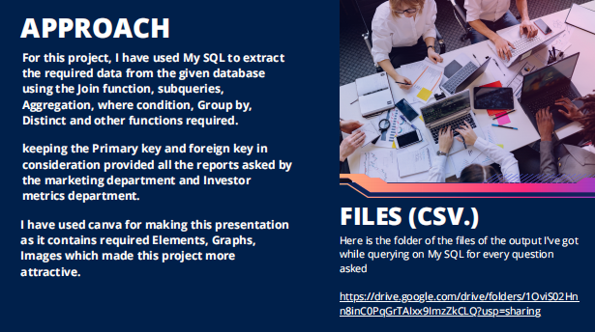

Slide 4
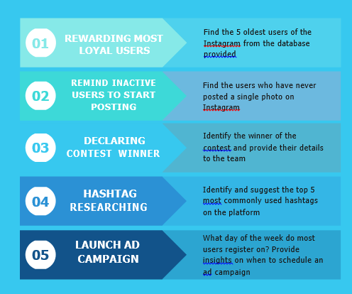

Slide 5
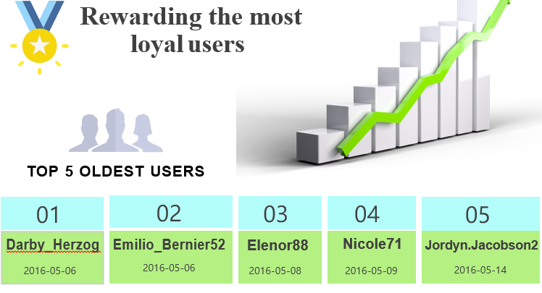

Slide 6
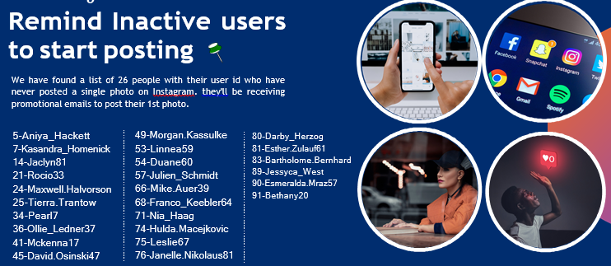

Slide 7
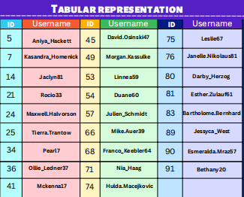

Slide 8


Slide 9
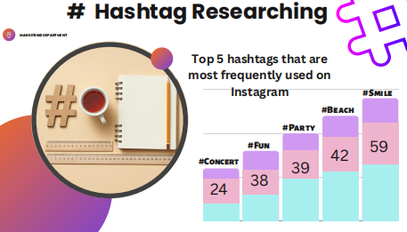

Slide 10
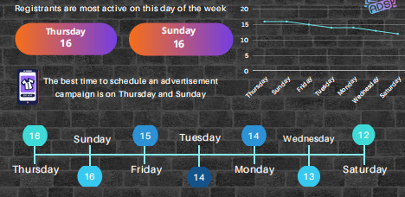

Slide 11
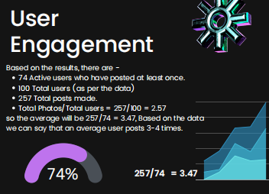

Slide 12
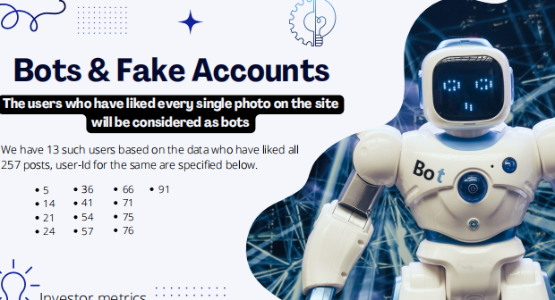

Slide 13
